Slide 1
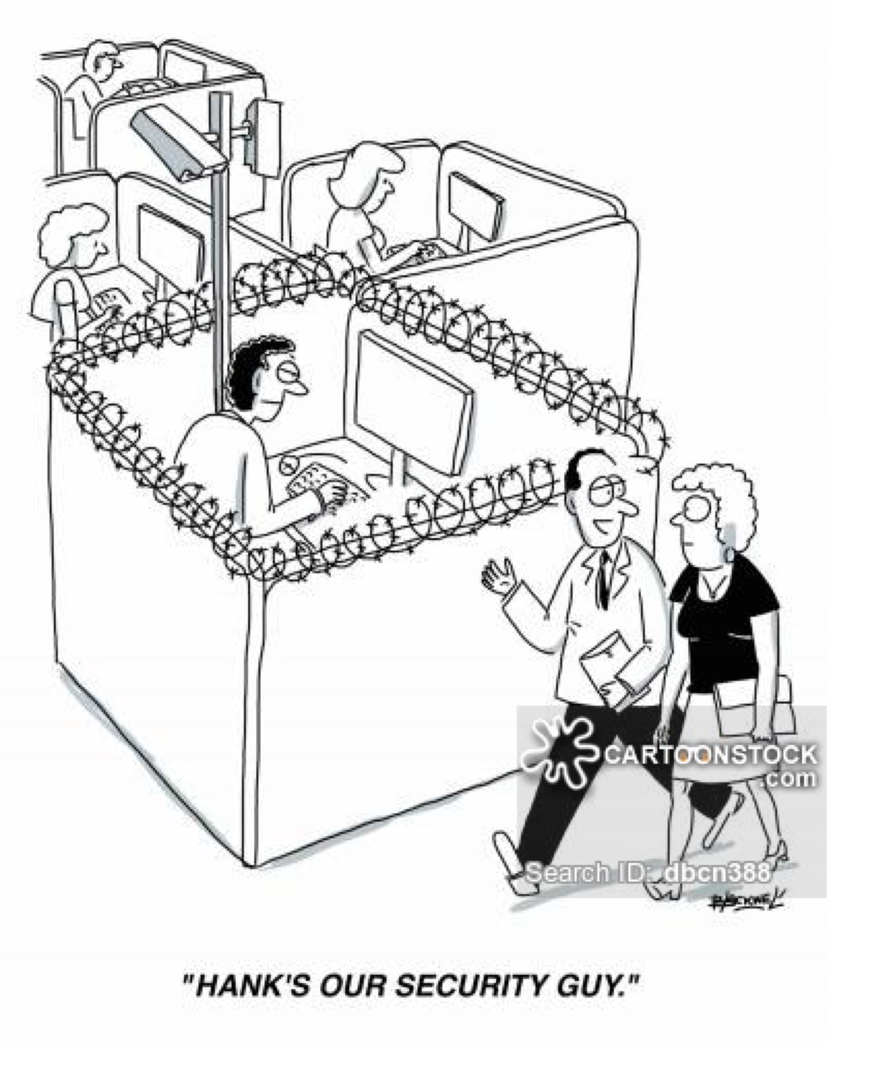

Slide 2
CYBERCRIME!
IT Systems Security and Information Privacy in the Internet Era
What does it mean and why does it matter?
Lecture 9

Slide 3
The only truly secure system is one that is powered off, cast in a block of concrete and sealed in a lead-lined room with armed guards - and even then I have my doubts. Dr. Eugene H. Spafford Purdue University

Slide 4
So what is happening…
… some major shifts are taking place
Consumers in open societies increasingly get enabled to do more themselves and the way they want it
Increasingly, technology makes it possible
Bad guys see it as an opportunity for personal, commercial or even political gains

Slide 5
Let’s take a look at the technological MacroTrends
Technological imperative - none other than Internet Protocol (IP) based network of essence…uniformity
Competitive imperative – a majority of financial services and many non-financial services can be delivered more cost efficiently via web technologies (eg. media distribution… Napster-style)
Customer demand - many new functions and services are not possible outside of Internet world while being a “natural” fit within it; consumers want them
“Catch the wave” – billions of $$ are being spent on web technologies and systems… no-one can win by betting against this trend… it is a good business practice to leverage other’s work
Standards - adoption of best practices and standards in retailing, network strategy and transaction processing is beneficial for companies, but introduces an interesting set of challenges

Slide 6
The world is more dangerous today
We are not dealing with a proprietary network anymore where each point was clearly identified but with Internet, involving:
Automation
Computer are good at dummy, repetitive tasks. The salami attack (stealing fractions of pennies from everyone’s interest accounts) is not feasible in the physical world.
Brute-force and DDoS attacks
Speed of propagation
Only the first attacker need to be skilled; everyone else can use his/her software. Currently dozens of sites let you download computer viruses, hacker tools are available on the net to exploit the software vulnerabilities in almost real time.
Attack at distance
Internet has no borders. Systems will have to prevent attacks from the worldwide criminals 24x7.
Very difficult to conduct investigation and prosecution

Slide 7
So, Welcome to Cyberspace
You are the target of someone !!
Computer Security Institute report: 70% of the surveyed respondents acknowledge suffering from attacks (12% don’t know)
In this global economy
Information is the life’s blood of commerce and power
Information warfare may be devastating against critical infrastructures
Consumers can be (are!) easy targets
ALL successful businesses embrace new technologies
Cyberspace attacks benefit from Internet characteristics: automation – remote access - speed of propagation
Cyberspace has become the default place for commerce, communication, creativity and CRIME

Slide 8
The World Would Be a Secure Place Without People
Bottom 12% of population will commit crimes
Top 12% will never commit any crime
The middle 76% will commit crimes given the right opportunity

Slide 9
Those who we are supposed to Trust … the AUTHORISED Users… are sometimes the worst
Fact: Many security violations are committed or enabled by authorized users, primarily through negligence
Fact: 30% of network access permissions are allocated to non-existent users
Generic, multi-user accounts
Average damages from a single user attack over $2 Million
Fact: 70% of all intrusion investigations turn out to be inside jobs in collusion with an outsider

Slide 10
Cases of special significance
In the last few years NASA, the CIA, the Whitehouse, IRS, Amazon, Doubleclick, Nitendo, McDonalds, New York Times, and dozens of other Web sites have been hacked
2003 – Microsoft development servers are hacked resulting in the illegal copying of proprietary source code by offshore hackers
2004- Choicepoint divulged private identity data on over 150,000 consumers to illegitimate subscribers who posed as legitimate businesses with the aid of an inside collaborator
2007 – TJX Corp (parent of TJ Maxx) had an intrusion which resulted in over 100,000 CC transactions being stolen off their servers.
2016 Federal Employee Database hacked by China
2020 Solar Winds Hack disabled systems across the world

Slide 11
Attacker’s profile
Type of attackers
Hacker, cracker, infowarrior, vandals
Insiders (majority of attacks)
Organized crime, terrorists
State Sponsored Cyber Terrorists
Attacker’s motivations
Publicity / challenge
Financial gain and Fraud
Thrill
Revenge
Intellectual property theft
Politics

Slide 12
How does it happen ?
Menu of threats… examples
Phishing
Unauthorized access
Eavesdropping
Data alteration
Software bugs
Security devices not configured correctly leading to security holes
Distributed Denial of Services
E-mail, Web and phone scams, posting false info.
Social engineering
RansomWare

Slide 13
What is at stake ?
We live by transacting with other economic agents… all our transactions can be seen, modified, fraudulently created
Other important data, including user’s data, programs, logs, archive, keys, business and technical electronic documents
Physical resources including computers, infrastructure, networks
Intellectual property, patents, know-how
Liability for the disclosure of confidential information (especially in Europe)
Disruption of key business activities and relationships (DDOS)
Brand, reputation and credibility

Slide 14
Cost of Cybercrime to Industry
Loss through theft or fraud
Loss due to business interruption
Loss of credibility by customers
Loss of Market Share
Cost of Prevention
Cost of Detection
Cost of Remediation
Cost of Monitoring

Slide 15
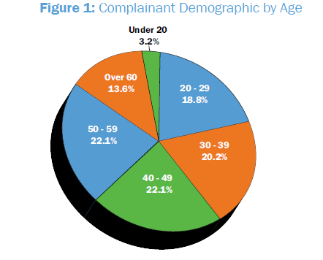
Cybercrime Demographics

Slide 16
Global Cost
Norton Study Calculates Cost of Global Cybercrime: $114 Billion Annually
One of World’s Largest Cybercrime Studies Reveals More Than One Million Victims a Day
According to the Norton Cybercrime Report more than two thirds of online adults (69 percent) have been a victim of cybercrime in their lifetime. Every second 14 adults become a victim of cybercrime, resulting in more than one million cybercrime victims every day4. The Norton Cybercrime Report reveals that 25 percent of adults online have experienced cybercrime on their mobile phone.

Slide 17
The Current Situation…and increasingly so….
Decreasing privacy
Social Networks – Data Vacuum Cleaners
Our personal information is the “blood” in the system
We live in an Age of Auto Surveillance
There is no statute of limitations on our digital lives
Globalized Cybercrime
Emergence of a Cyberspace Arms Race

Slide 18
Data breaches cost businesses an average of $4.35 million in 2022.
Around 236.1 million ransomware attacks occurred globally in the first half of 2022.
1 in 2 American internet users had their accounts breached in 2021.
39% of UK businesses reported suffering a cyber attack in 2023.
53.35 million US citizens were affected by cyber crime in the first half of 2023.

Slide 19
Mobile under increasing attack
And the people most at risk are men ages 18 to 34 who use mobile devices to connect to the internet. In other words, PCs pose a broadly dangerous entry point for cybercriminals, but smartphones are worse. The information is especially troubling because people use smartphones with increasing frequency as the primary tools for their online work and play. The number of new malicious programs targeting the Android platform has almost trebled in the second quarter of the year, according to figures from Kaspersky Lab’s Q2 report on IT threat evolution. Over the three months in question, over 14,900 new malicious programs targeting this platform were added to Kaspersky Lab’s database.

Slide 20
Let’s just face it…
The security perimeter is gone
Too many inter-connected networks & devices
Too many doors & windows from one environment to another to secure the network in the old-fashioned way
Today, difficult to say with certainty where one network/system ends and another
Due to complex series of interconnections, new/untested technology, people interactions, insecurity always remains
=> 100% security doesn’t exist

Slide 21
Security as a Discipline
There are several important aspects, or tenets of security
Identification/Authentication
Authorization
Privacy
Information integrity
Non-repudiation
System Availability
Security Enablers
Encryption
Digital Signatures
Public Key Infrastructure
Redundancy and Fault Tolerance
Biometrics
Virus and Malware Detection

Slide 22
What is Authentication ?
Answers the question “Who am I?”
Can be implemented with weak or strong methods but usually involves something you know, something you have, and/or something you are
User ID
Passwords
Other “secret” info
Digital Tokens or Certificates
Biometrics
It is the most common area of attack on IT systems because it opens so many other doors
Consumers are very vulnerable to attacks in this area because they are not very good at keeping secrets
Vulnerable to “Social Engineering”

Slide 23
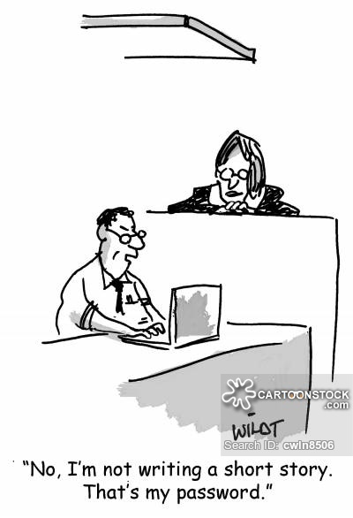
Authentication
Process to positively identify a party participating in electronic interaction
Attempting to answer the question:
who are you (identify)
are you who you say you are (confirm)
Methods based on:
Who you are (…fingerprint, retina, DNA)
What you know (…password, PIN)
What you have (…cards, digital certificates)
Examples:
UserID/Passwords
Cards (mag-stripe and chip)
PINs
Biometrics
Digital Certificates

Slide 24
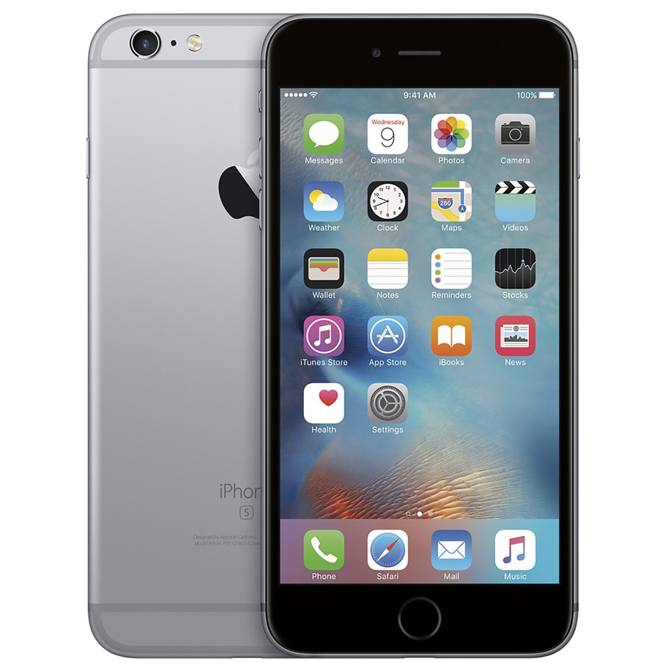
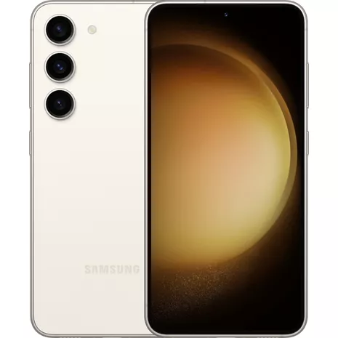
Today’s Digital Token
The most common
“Something you Have”

Slide 25
Currently used biometric technologies
Fingerprint verification
Hand geometry
Voice verification
Retinal scanning
Iris scanning
Signature verification
Facial verification
Keyboard Dynamics

Slide 26
Digital Certificates
Digital Certificates are digital files that are issued to you and are unique to you as an individual
In order to receive one, you must prove who you are to the Certificate Authority that issues the certificate to you
Certificates are issued in different “flavors” or strengths depending upon what they authorize you to do
The certificate may be used to digitally “sign” an electronic document and has the same legal status as your written signature

Slide 27
Weak vs. Strong Authentication
An example of “weak” authentication is:
Username and 4 character pin
Stronger authentication would be:
Username and 8 character alphanumeric password with no repeating characters
Even Stronger authentication would be:
Username +
16 character alphanumeric pw with no repeating characters +
Biometric signature and/or a Digital Certificate

Slide 28
Authorization
Ensure that the right person has the access to the right resource
Access control lists… the most common means
Often used a back door to compromise the system (it is often easer to move up on the authorization ladder than to get on the ladder in the first place)
Social Engineering commonly used to “fake” authorization
Boston College computer fraud is a classic case

Slide 29
Privacy
Keep data undecipherable to unauthorized persons
The use of Encryption Technology
The application of Virtual Private Networks (VPN)
And mostly about intentional misuse of personal data

Slide 30
Privacy
Cryptography is concerned with keeping communications private
Cryptology (from the Greek kryptós lógos, meaning ``hidden word'')
Encryption is the transformation of data into a form that is as close to impossible to read as possible without the appropriate knowledge (key)
Decryption is the reverse of encryption
Encryption and decryption generally require the use of some secret Information, referred to as a key
Encryption keys are usually large PRIME numbers

Slide 31
Integrity
Keep data free from tampering
Not the same as privacy (do not need to understand the data to change it unnoticed)
Don’t need to know what was changed… just that it was changed

Slide 32
Non-repudiation
Provide legally binding proof that a certain transaction took place between certain actors
Three issues:
Data non-repudiation (what happened)
Party non-repudiation (who did it)
Trusted 3rd party certification (similar to an escrow service)

Slide 33
Availability of Service Issues
The popularity of the Internet has made Denial of Service a favorite pastime of certain hackers
Disruption of service due to worms and viruses
Hacking a website so as to make it unusable
File tampering and destruction
Denial of service attacks have become a form of blackmail and Ransomware

Slide 34
Identity Theft….a growing menace
Has become the number one complaint from consumers to Law enforcement dealing with cyberspace crimes
In the U.S. someone’s identity is stolen every 60 seconds at an average loss of over $6000 to the victim
Usually achieved with a combination of Social Engineering and hacking
Involves building a profile of the target from many possible sources and scams

Slide 35
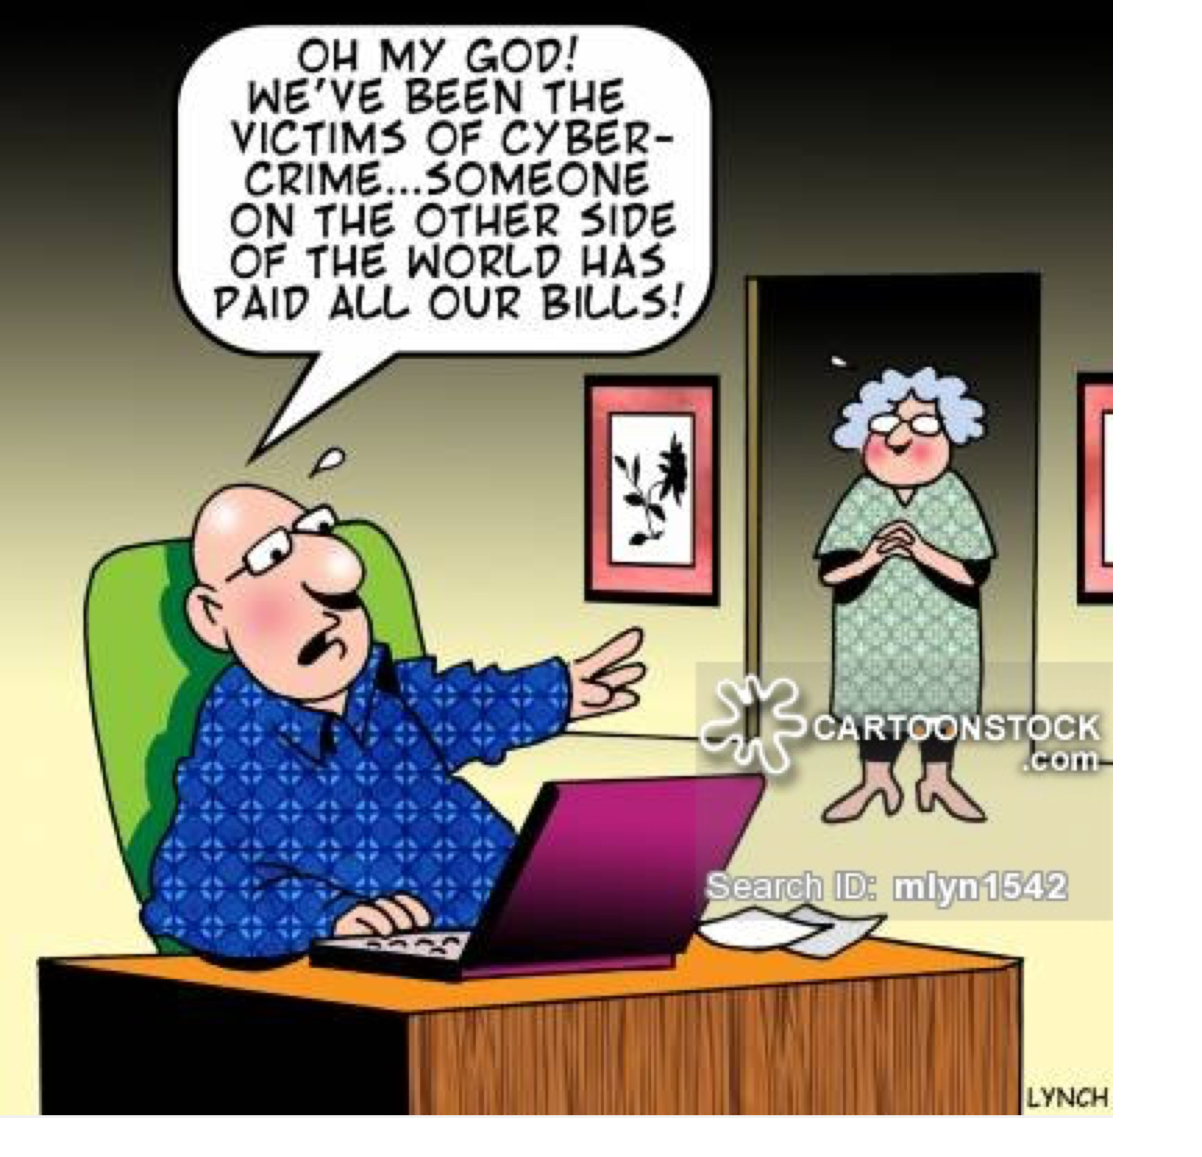

Slide 36
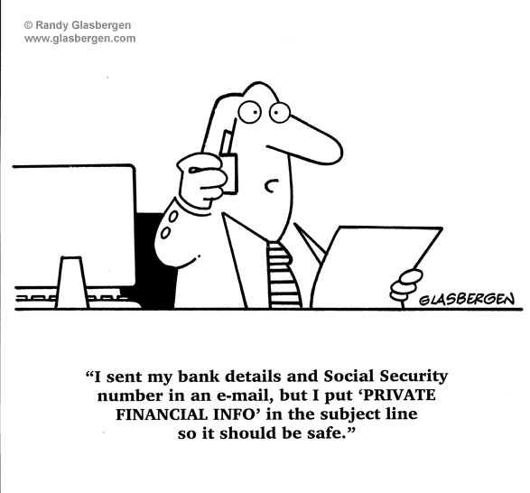
Identity Theft
“What do they want?”
Your name
Date of Birth
Address
Telephone numbers
Driver's License
Credit card account numbers
Bank account numbers
Social Security Number
Or any combination of the above!
Private Financial Info

Slide 37
Threats to the Internet Itself
What would happen to the global economy if someone successfully attacked the domain name servers that assign all of the internet addresses and URL’s
Worldwide Chaos
Huge business failures
Major disruption to every large national economy
Major disruption in government services
Consumer Panic similar to a stock market crash
Retailing, Travel, Banking, Insurance, Brokerage and News services all crippled
No more free downloads!

Slide 38
Security Utopia
An illusion is often propagated that the computer system is secure when there are:
Security guards + video system
A set of security policies and procedures
System backups + fire detection + UPS
Some smart software and hardware in place
Everything is placed in a locked vault…underground
When in fact this is just a first line of defense….. it is never enough….

Slide 39
A Quote for the Day….
Secure web and email servers are the equivalent of heavy armored cars. The problem is, they are being used to transfer rolls of coins and checks written in crayon by people on park benches to merchants doing business in cardboard boxes from beneath highway bridges. Further, the roads are subject to random detours, anyone with a screwdriver can control the traffic lights, and there are no police.

Slide 40
take a look!
hackmageddon.com
http://www.justice.gov/criminal/cybercrime/cc.html
http://www.computerworld.com/s/topic/82/Cybercrime+and+Hacking

Slide 41
Where do we go from here? (come back for the next lecture)

Slide 42
Thursday Millionaire Quiz !!!!!

